Slide 1
Analyzing Amazon Sales data

Slide 2
INTRODUCTION
Analyzing Amazon Sales Data involves examining the information related to sales made on the Amazon platform which offers unparalleled opportunities for businesses to identify trends, understand consumer behavior, optimize product offerings, and enhance overall performance. By analyzing this Amazon data , sellers can make informed decisions to enhance their sales and grow their business on Amazon.
It studies what people buy, when they buy, and how much they pay, businesses can make smarter decisions. This helps them sell more, understand their customers better, and compete effectively.

Slide 3
PROBLEM STATEMENT
Sales management has gained importance to meet increasing competition and the need for improved methods of distribution reduce cost and to increase profits. Sales management today is the most important function in a commercial and business enterprise.

Slide 4
Techniques
Customer Lifetime Value (CLTV): Calculate customer worthiness.
Data Cleaning
Exploratory Data Analysis(EDA)
Statistical Analysis
Predictive Modeling
Segmentation
Customer Lifetime Value (CLTV)
A/B Testing
Data Visualization

Slide 5
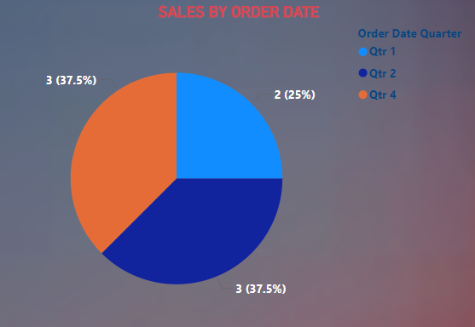
Sales by order date

Slide 6
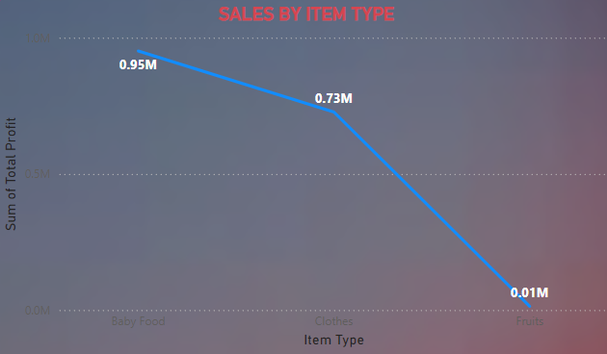
Sales by item type

Slide 7
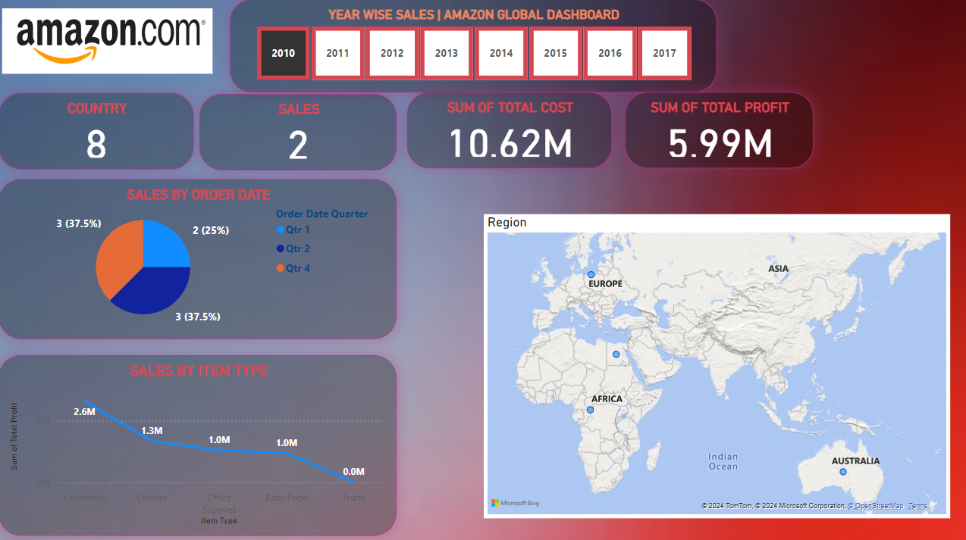
MY DASHBOARD

Slide 8
THANK YOU

